Slide 1

Internal Assessment Portal
UNDER GUIDANCE OF
Mr. Anand Kr. Srivastava

Slide 2
TEAM MEMBERS GROUP NO-12
DEVESH Roll no –1803210048 Admno-2018bcs1095 Cse-B
Sanjeev Sagar Roll No- 1803210131 Admno-2018bcs1089 Cse - C
NITISH GIRI Roll no –1900320109011 Admn-2019B103001 Cse-B

Slide 3
PROJECT OBJECTIVE
Objective of internal Assessment Portal is online and easy
solution for students internal marks assessment. Faculties
can upload their marks, Hod’s or department can fix the
rules for marks assessment and According to this marks
will be calculated. Finally students can see their own marks
in their own login.

Slide 4
TECHNOLOGY USED
HTML5.0 CSS3.0 JS JQ JSP MySqL

Slide 5
FRAMEWORK USED
jQuery is a JavaScript library designed to simplify HTML DOM tree traversal and manipulation, as well as event handling, CSS animation, and Ajax.
CSS framework It contains CSS- and JavaScript-based design templates for typography, forms, buttons, navigation, and other interface components.

Slide 6
MODULES
ADMIN
STUDENT
FACULTY
HOD

Slide 7
STUDENT MODULE
Student admission No / Roll No will be user id
After Registration, students can login
Student can forgot password
Student will register first time
can view their Profile
Student can edit their profile
Student can Logout
Student can view their registered Subjects
Student can view Sessional Marks(if uploaded)
Student can raise any query in sessional marks changes to corresponding subject Faculty

Slide 8

ADMIN MODULE
Admin can add the Hod
Admin can provide Hod password
Admin can manage all data

Slide 9

FACULTY MODULE
Faculty can add student and add subjects
Faculty can login with their employee id and given password
Faculty can Change their password
Faculty can Modify the students and subjects
Faculty can view the students query and update the marks
Faculty can forgot password
Faculty can logout

Slide 10

HOD MODULE
Hod can login with their employee id and given password
Hod can change their password
Hod can forgot the password
Hod can add subjects for their own department semester wise
Hod can modify subject detail
Hod can fix the maximum marks for sessional breaks
Hod can modify any student’s marks individually on any
recommendation
Hod can view the marks subject /semester wise
Hod can fix rules to calculate the sessional marks
Hod can logout

Slide 11
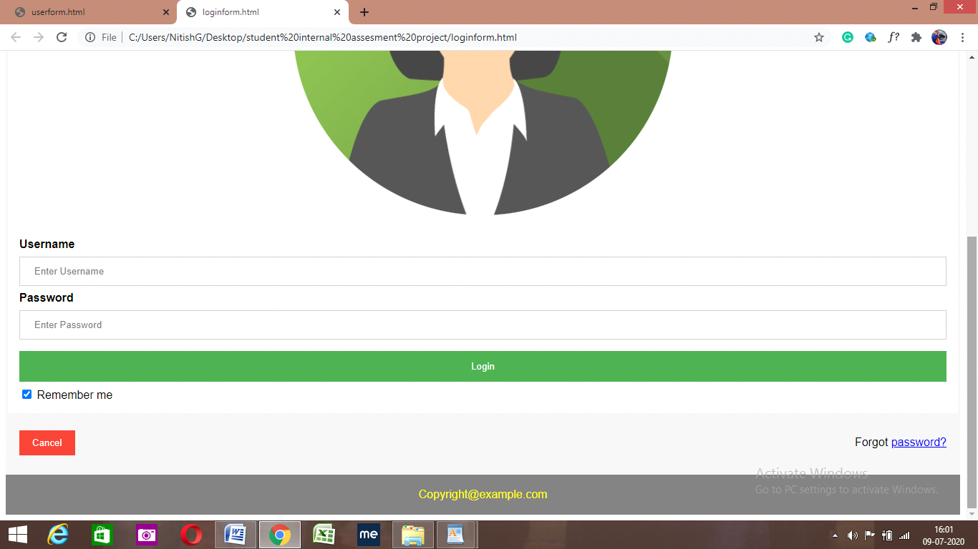
sample UI screens LOGIN

Slide 12
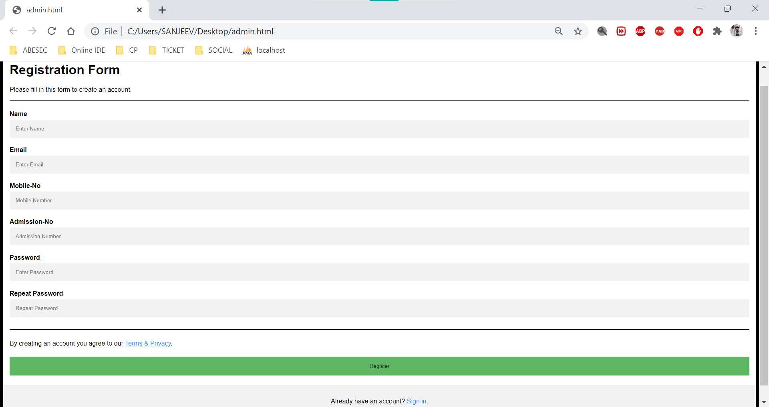
REGISTRATION PAGE

Slide 13
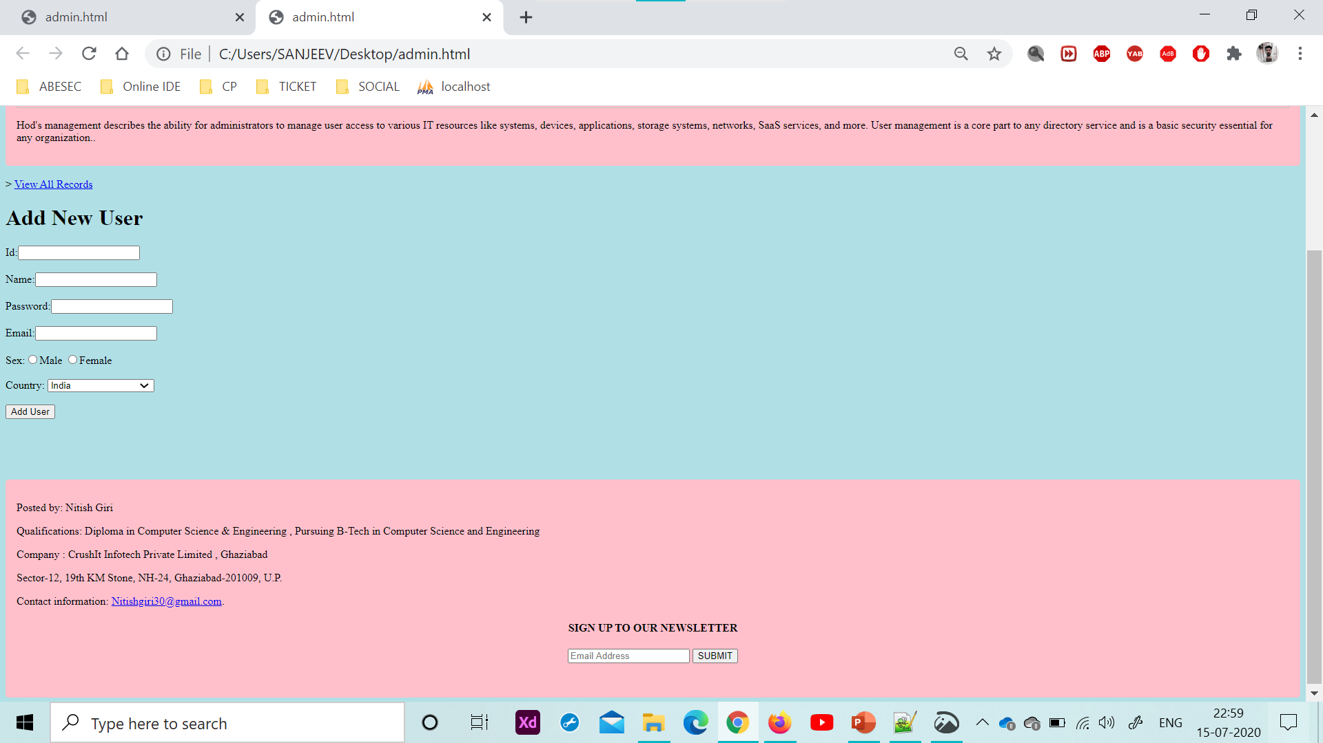
USERFORM

Slide 14
THANKS!

